Slide 1
Project 1 – Box Office Oracle
Creating a predictive analysis of various factors that will make
a movie a top 10 box office hit.
Isabel Buechsel
Grace Chan
Jason Do
Fathi Elshibani

Slide 2
What makes a movie a top 10??
Top 10 movies will have a well-defined marketing strategy that gears to a mass audience through well directed movie trailers and must be widely distributed in as many theaters as possible
Directors of the movies should be highly influential amongst fans which will add to the popularity and appeal of the movie.
Having high ratings on the top 3 popular review sites will increase the likelihood of attracting audience into the theaters to watch a movie

Slide 3
Research Approach
1. Select top 10 movies for the year for 5 years
2. Extract Movie Variables
MPAA & Critic Ratings
Director
Actor
Box Office Gross
Number of Theaters
Year
Distributor & Production Studio
Release Date
RunTime
3. Extract Social Media Variables
YouTube; Trailer Views, Trailer Likes, Trailer Dislikes, Trailer Comment Count
Twitter Director; Follower Count, Comments Favorited, Retweets
4. Merge Data
5. Plot & Analyze

Slide 4
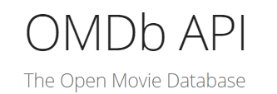
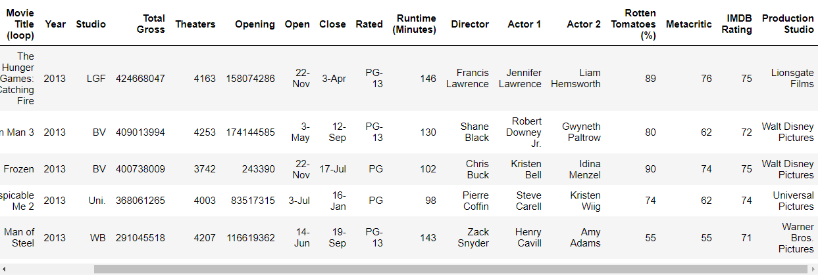

Slide 5
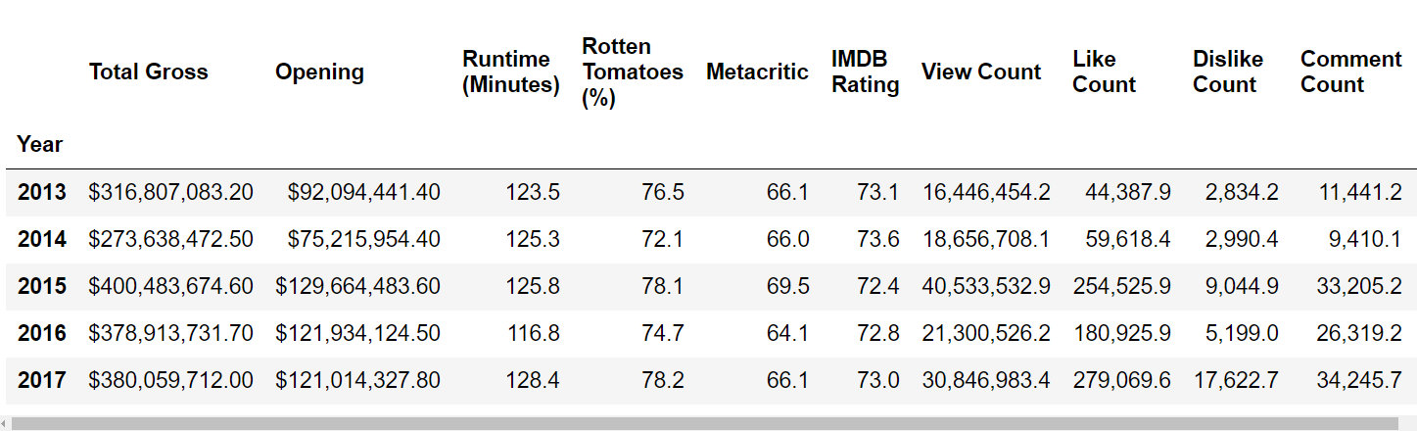
5 Year Average Trend

Slide 6
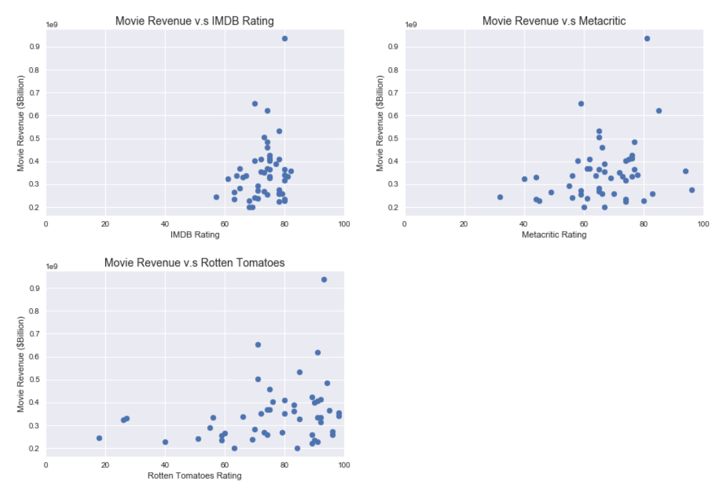

Slide 7
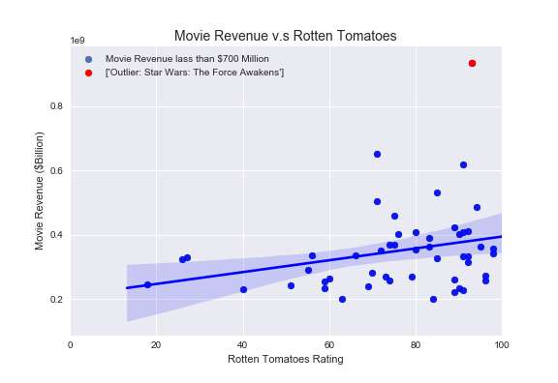

Slide 8
Movie Ratings (MPAA)
Impact on Average Gross Per Movie
Only 4 top 10 movies were either rated G or R
The group rating with the highest average gross per movie is PG-13

Slide 9


Slide 10
Official Movie Trailer View Count v. Overall Gross
Question: Do movie trailer views indicate what the overall gross of a movie would be?
Assumption: Viewing a movie trailer indicates general interest in the movie
Process:
- YouTube Search API: use 3 keywords(“Movie” + “Trailer” + Movie Title) to return a Video ID
- YouTube Video API : use Video ID to return statistics on the video

Slide 11
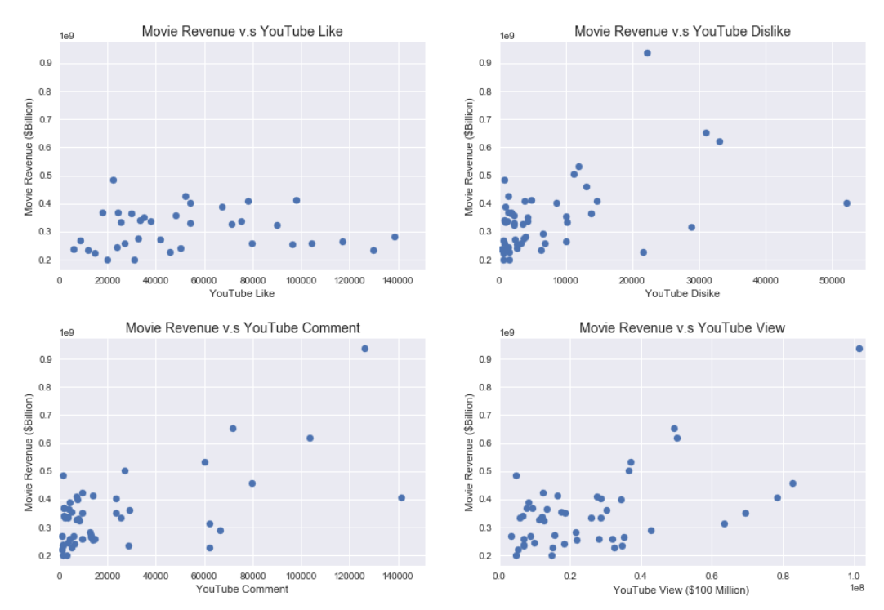

Slide 12
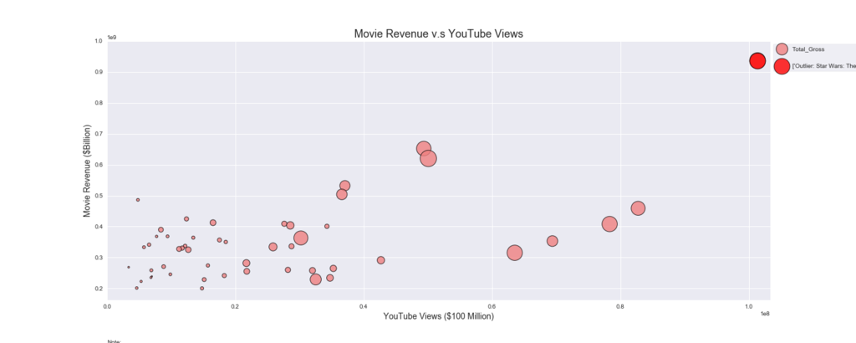
Official Movie Trailer View Count v. Overall Gross
Star Wars: The Last Force Awakens (JJ Abrams)
Bubble Size: Like Count

Slide 13

Star Wars: The Force Awakens had the highest number of movie trailer views and also the highest overall gross revenue

Slide 14



Director

Slide 15

How does the twitter popularity of Movie Directors affect movie performance?
Assumption:
Directors of the movies should be highly influential amongst fans which will add to the popularity and appeal of the movie.

Slide 16
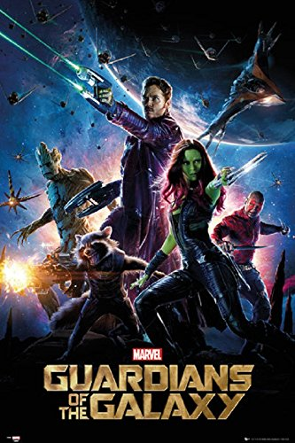




Directors with the most top 10 movies in the last 5 years
Interesting Fact: Only one female director (with top director credit) had a top 10 movie in the past 5 years
Patty Jenkins for Wonder Woman

Slide 17
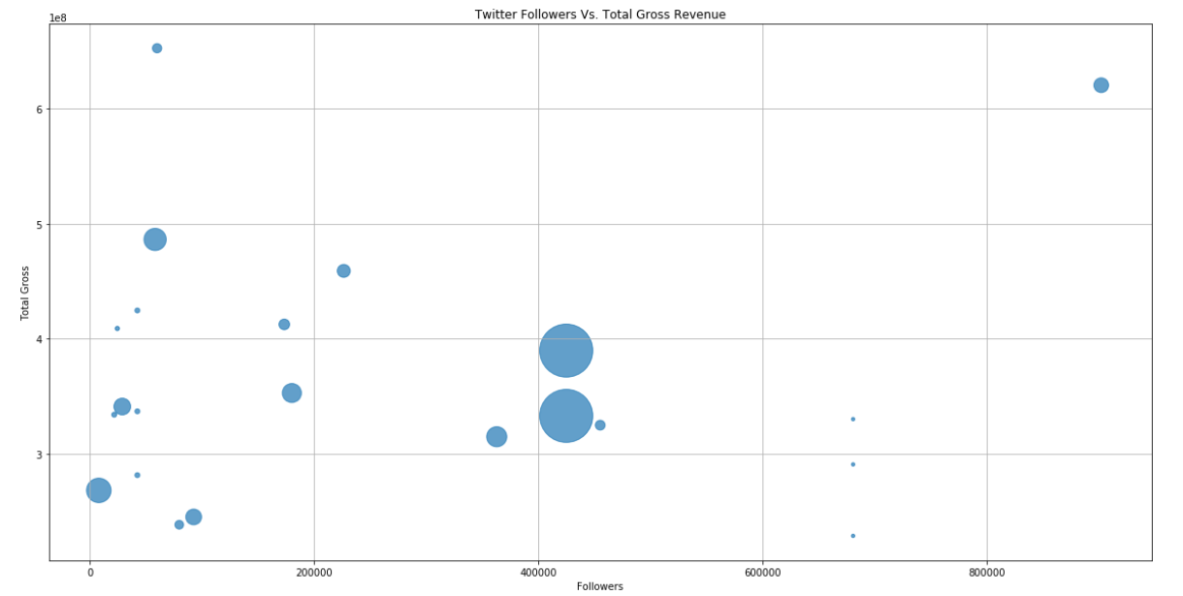
Bubble Size: Tweets
Star Wars: The Last Jedi (Rian Johnson)
Guardians of the Galaxy Vol. 1 & 2 (James Gunn)
The popularity of director is not a key factor in driving box office revenue.
Being part of a franchise appears to be key in determining box office revenue
Batman vs. Superman
Man of Steel
Justice League (Zack Snyder)

Slide 18

Release Date

Slide 19
Release Date of Top 10 Movies
Question: Does the month of the release date have an impact on the overall gross of a movie?
Assumption: There will be more Top 10 movies released during the summer and winter months to correspond with the time students are on break.
Process:
- Use CSV file containing data from Box Office Mojo to gather the release date
- Find corresponding month from release date data

Slide 20


Top 10 Movies by Release Month
Top Winter Movie: December 18
Top Summer Movie
June 12

Slide 21

Director
Challenges

Slide 22
Challenges: Twitter Movie Mentions and Sentiment
Question: Do the number of Twitter mentions and overall sentiment indicate what the overall gross of a movie would be?
Assumption: More Twitter mentions would generally correlate with a higher overall gross.
Process:
- Looking at Twitter mentions using hashtags
- Looking at Twitter movie handles
Issue:
- Understanding how the average Twitter user tweets
Resolution:
- Used the YouTube API instead

Slide 23
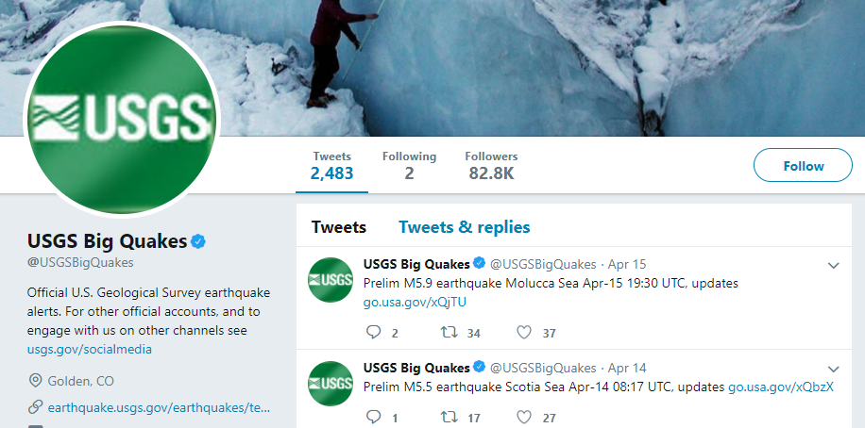

Challenges: Twitter Mentions
Do users tweet at the handle or use hashtags?
Assumption:
If people are tweeting about a movie they do not normally tweet at the handle
Example:
If there is an earthquake, most users would tweet #earthquake, not tweet @USGSBigQuakes handle
Issues:
Not every movie has its own handle (i.e. @Iron_man for all its movies)
Requires a manual search for handle names

Slide 24


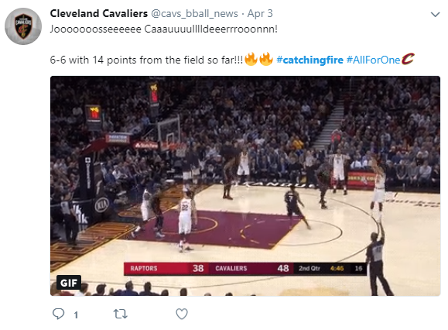
Challenges: Twitter Mentions
Knowing what hashtags users might use
Some movies need multiple hashtags to return the most relevant tweets
This requires a manual process of assuming what most people would tweet
#Smaug #DesolationofSmaug #Hobbit
#HungerGames #CatchingFire
#Frozen #Gravity were too common
- Some movies are unique: #BigHero6

Slide 25
Key Takeaways:
Holidays are good for box office revenues
Family-friendly films (PG/PG-13 MPAA rated) have the highest average revenue
Overall, critic ratings have a constant score range for top 10 box office hits
Rotten Tomatoes critic ratings are positively correlated with box office revenue
YouTube movie trailer views and likes correlate with overall box office revenue
The popularity of the director is not a key variable in determining the box office revenue
The most successful movies are part of franchises with a highly engaged fan base

